Slide 1
ReBoot Module 2: Statistics
Week 1 Saturday Lecture:
Correlation & Regression

Slide 2
Correlation
Correlation is used to describe the relationship between quantitative variables when you have bivariate or multivariate data. We will begin by exploring bivariate correlation.
If two variables are correlated, having information about one variable provides you additional information about the other.
Example: Because age and salary are strongly correlated, I know someone who is older is more likely to make more money than someone who is younger. It does not guarantee this relationship, but it tells me that it is likely.

Slide 3
Pearson Coefficient of Correlation: r
The Pearson correlation coefficient, r, is a number between -1 and 1 that indicates the strength and direction of the linear relationship between two variables.
r = 1 is a perfect, positive linear relationship (the data forms a straight line with a positive slope).
r = -1 is a perfect, negative linear relationship (straight line, negative slope).
r = 0 indicates there is no linear relationship between the variables
A non-zero value for r implies that knowing a value for the independent variable provides you some information about the dependent variable.
Notes:
Independent variable is the variable that is changed or controlled in an experiment, denoted by x. Dependent variable is the variable that is being tested or measured, denoted by y.

Slide 4

Pearson Coefficient of Correlation: r
We will use software to calculate the value of r, but note in the formula that it comes from the distance from each value’s x and y to the mean x and y.
Notes:
Independent variable is the variable that is changed or controlled in an experiment, denoted by x. Dependent variable is the variable that is being tested or measured, denoted by y.

Slide 5
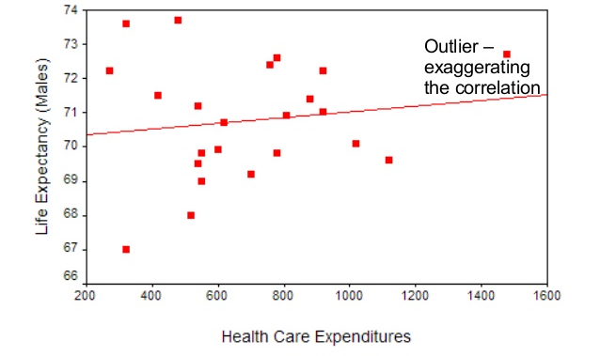
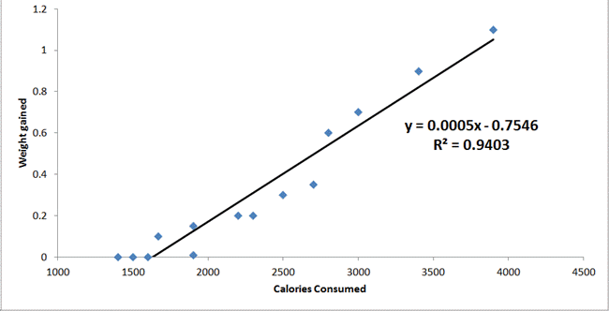
Visualizing Pearson Correlation

Slide 6
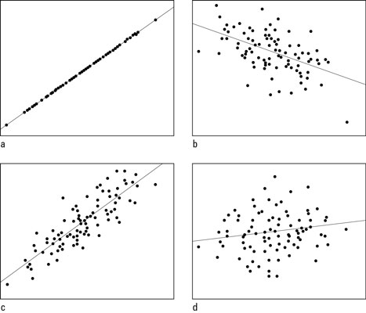
Visualizing r
1.0
Estimae the correlation coefficient of each scatter plot:
Explore more for yourself: http://digitalfirst.bfwpub.com/stats_applet/stats_applet_5_correg.html
-0.5
0.15
0.85

Slide 7
Coefficient of Determination, r²
Often, r² is reported along with r. It has its own name and definition. r² is called the Coefficient of Determination. It describes what percent of the variability in y is explained by changes in x.
Example:
According to this scatter plot, approximately 94% of the change in weight gain is explained by change in calories consumed.
What could possibly explain the other 6% of change in weight gain?

Slide 8
Pearson Correlation Coefficient Key Points:
r gives you strength and direction of a linear relationship
r has no units
r assumes the data has linear and homoscedastic (homogeneity of variance: data is equally distributed about the regression line). You can calculate r for any relationship, but it is only appropriate for linear relationships.
r close to 1 or -1 is a strong relationship, close to 0 is weak
The stronger the correlation, the more accurately you can predict y for a given x
r indicates a correlation, but does not indicate causation

Slide 9
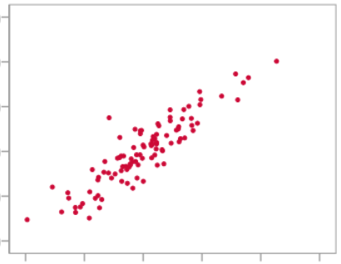
Correlation vs. Causation
Does this scatter plot imply that the independent variable causes change in the dependent variable?
Ice Cream Sales
Drowning Deaths

Slide 10
Correlation vs. Causation
Correlation does not imply causation.
There are many alternative explanations for a relationship between two correlated events A and B:
A causes B (direct causation);
B causes A (reverse causation);
A and B are consequences of a common cause, but do not cause each other (a confounding variable);
A and B both cause C, which is (explicitly or implicitly) conditioned on;
A causes B and B causes A (bidirectional or cyclic causation);
A causes C which causes B (indirect causation);
There is no connection between A and B; the correlation is a coincidence.

Slide 11
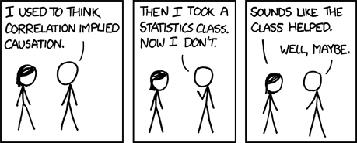
Correlation vs. Causation
Generally, to determine causation you must have a well-designed experiment or study.
https://xkcd.com/552/

Slide 12
Simple Linear Regression (Single Regression)
Linear regression is a linear approach to modelling the relationship between a response variable y (or dependent variable) and one or more explanatory variables x (or independent variables). In this course we will focus on a single explanatory variable (aka single regression).
The goal of all types of regression is to be able to make predictions of a dependent variable. When we fit a regression line, it gives us predictions of y for values of x.

Slide 13
Least Squares Regression
Simple linear regression is also called Least Squares regression. That is because it minimizes the square of the residuals for all of the points to the line. Residuals are the prediction error for the actual points (the vertical distance from each point to the line).
To visualize what the LSRL is minimizing, explore this applet:
https://phet.colorado.edu/sims/html/least-squares-regression/latest/least-squares-regression_en.html

Slide 14
Regression Notebook
We’ll now walk through Notebook 3_Regression.ipynb

Slide 15
Residuals
As mentioned before, Residuals are the prediction error for the actual points (the vertical distance from each point to the line).
Residuals can also be used to evaluate the appropriateness of our chosen model. By plotting the residuals, we can look for any patterns. If there is a pattern to the residual plot, that means there is information not being captured by our selected model.

Slide 16
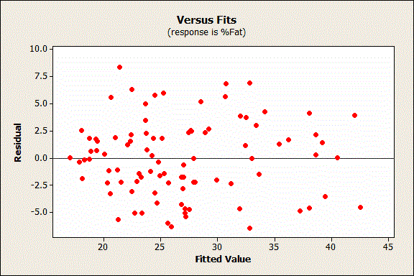
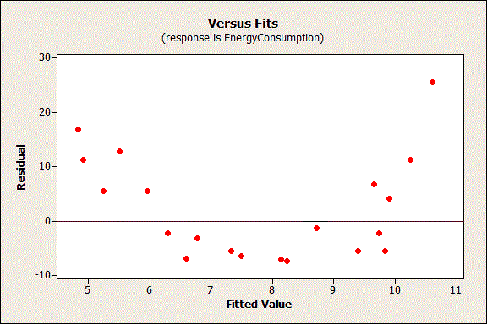
Residual Plots
Compare the two plots. The plot on the left looks like a random scatterplot. The plot on the right looks more like a quadratic curve. That means that the data on the right have a relationship that is not completely captured by the regression model.

Slide 17
Residual Plots
The model chosen for the left graph is appropriate. The model chosen for the right graph is not.

Slide 18
Residual Plots Notebook
We’ll now walk through Notebook 4_Residual_Plots.ipynb

